Slide 1

Learning Objectives
LO1 Prepare an income statement for a service business.
LO2 Calculate and analyze financial ratios using income statement amounts.
© 2014 Cengage Learning. All Rights Reserved.

Slide 2
Reporting Financial Information
Lesson 7-1
LO1
The area of accounting that focuses on reporting information to external users is called financial accounting.
The area of accounting that focuses on reporting information to internal users is called managerial accounting.

Slide 3
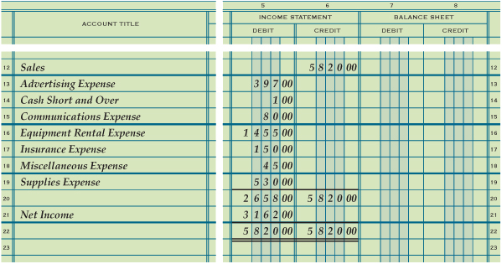
Preparing an Income Statement from Information on a Work Sheet
Lesson 7-1
LO1
Information needed to prepare the income statement is obtained from the work sheet.
Account titles are obtained from the work sheet’s Account Title column.
Account balances are obtained from the work sheet’s Income Statement columns.

Slide 4
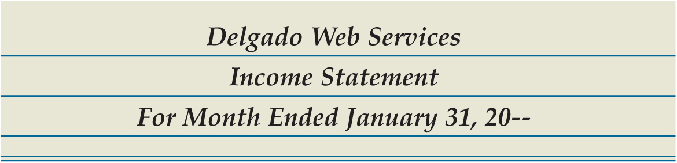
Heading of an Income Statement
Lesson 7-1
LO1
Center the name of the company on the first line.
1
3
Center the date of the report on the third line.
2
Center the name of the report, Income Statement, on the second line.

Slide 5
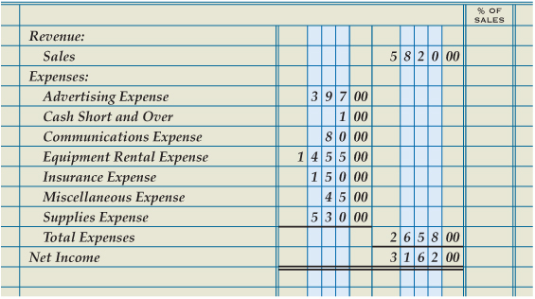
Revenue, Expenses, and Net Income Sections of an Income Statement
Lesson 7-1
LO1
Revenue
1
2
Account Title
6
Expense Amounts
3
Revenue Amount
Expenses
4
Account Titles
5
10
Calculate Net Income
9
Total of Expenses
Total Expenses
8
11
Single Rule
Net Income
12
Single Rule
7
Double Rule
14
13
Record Net Income

Slide 6
Analyzing an Income Statement
Lesson 7-1
LO2
A comparison between two components of financial information is called a financial ratio.
The calculation and interpretation of a financial ratio is called ratio analysis.
Reporting an amount on a financial statement as a percentage of another item on the same financial statement is called vertical analysis.

Slide 7
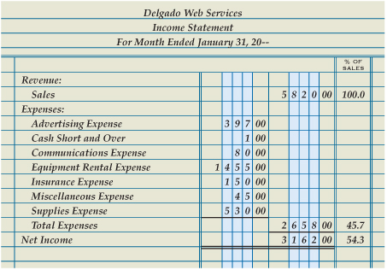
Analyzing an Income Statement
Lesson 7-1
LO2
Total Expenses Ratio
Total Expenses ÷ Total Sales = Total Expenses Ratio
$2,658.00 ÷ $5,820.00 = 45.7%
Net Income Ratio
Net Income ÷ Total Sales = Net Income Ratio
$3,162.00 ÷ $5,820.00 = 54.3%

Slide 8
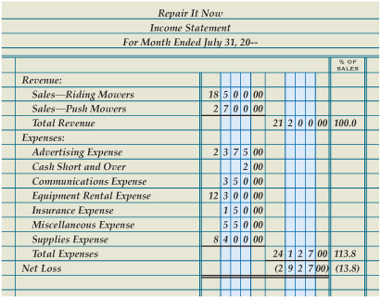
Income Statement with Two Sources of Revenue and a Net Loss
Lesson 7-1
LO2
Revenue
1
3
Revenue Amounts
Account Titles
2
Total Revenue
5
4
Total of Revenue
Net Loss
6
Record Net Loss
7

Slide 9

Lesson 7-1 Audit Your Understanding
Lesson 7-1
1. List the four sections of an income statement.
ANSWER
Heading, revenue, expenses, and net income or net loss

Slide 10
Lesson 7-1 Audit Your Understanding
Lesson 7-1
2. What is the formula for calculating the total expenses ratio?
ANSWER
Total Expenses divided by Total Sales equals Total Expenses Ratio.

Slide 11
Lesson 7-1 Audit Your Understanding
Lesson 7-1
3. What is the formula for calculating the net income ratio?
ANSWER
Net Income divided by Total Sales equals Net Income Ratio.

Slide 12
Work Together 7-1 On You Own 7-1
Work Together
Modeled
On Your Own
Complete

Slide 13

Learning Objectives
LO3 Prepare a balance sheet for a service business organized as a proprietorship.
© 2014 Cengage Learning. All Rights Reserved.

Slide 14
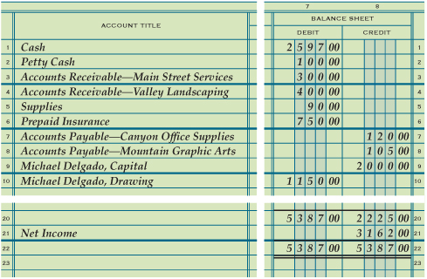
Preparing a Balance Sheet from Information on a Work Sheet
Lesson 7-2
LO3
Information needed to prepare the balance sheet is obtained from the work sheet.
Account titles are obtained from the work sheet’s Account Title column.
Account balances are obtained from the work sheet’s Balance Sheet columns.

Slide 15

Heading of a Balance Sheet
Lesson 7-2
LO3
Center the name of the company on the first line.
1
3
Center the date of the report on the third line.
2
Center the name of the report, Balance Sheet, on the second line.

Slide 16
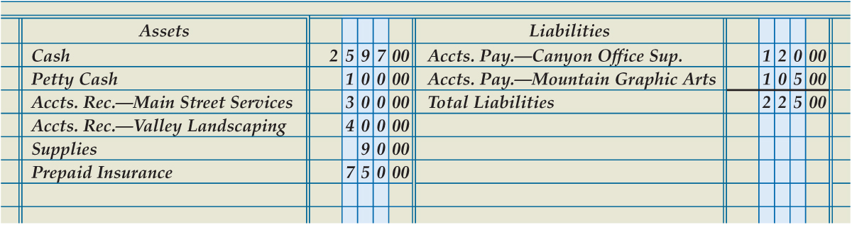
Assets and Liabilities Sections of a Balance Sheet
Lesson 7-2
LO3
2
Account Titles
Liability Amounts
6
1
Assets
5
Account Titles
4
Liabilities
3
Asset Amounts
8
Total Liabilities
7
Single Rule
9
Total of Liabilities

Slide 17
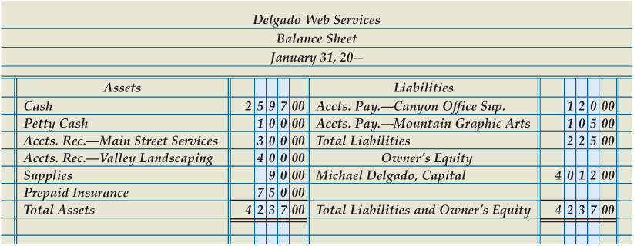
Owner’s Equity Section of a Balance Sheet
Lesson 7-2
LO3
1
Owner’s Equity
2
Account Title
3
Capital Amount
4
Single Rule
5
Total Assets
9
Compare Totals
10
Double Rule
6
Total of Assets
7
Total Liabilities and Owner’s Equity
8
Total of Liabilities and Owner’s Equity

Slide 18
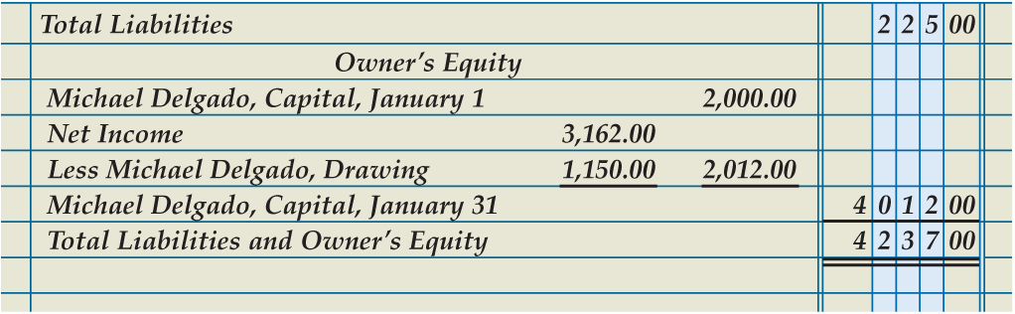
Owner’s Equity Reported in Detail on a Balance Sheet
Lesson 7-2
LO3
1
Beginning Capital
2
Beginning Capital Amount
3
Net Income
Drawing
4
6
Difference
7
Ending Capital
5
8
Single Rule
Current Capital Amount
9
Total Liabilities and Owner’s Equity

Slide 19
Lesson 7-2 Audit Your Understanding
Lesson 7-2
1. List the four sections on a balance sheet.
ANSWER
Heading, assets, liabilities, and owner’s equity

Slide 20
Lesson 7-2 Audit Your Understanding
Lesson 7-2
2. What is the formula for calculating current capital?
ANSWER
Capital Account Balance plus Net Income (or less Net Loss) less Drawing Account Balance equals Current Capital.

Slide 21
Work Together 7-2 On You Own 7-2
Work Together
Modeled
On Your Own
Complete

Slide 22
Application Problems
7-1 Application Problem
Self-Correcting Excel
7-2 Application Problem
Self-Correcting Excel

Slide 23
Application Problems
7 Mastery Problem
Excel
7 Challenge Problem
Peachtree

Slide 24
Unit 7 Assessment
Unit 7 Review (ExamView)
90 % or Greater
5 Point Bonus on Unit 1 Concept Quiz (20% Bonus)
Unit 7 Part 1 Quiz (ExamView)
Concepts – 25 Questions (25 Points)
Unit 7 Part 2 Quiz (Excel)
Skills (30 Points)

